Slide 1
Chapter 11 Bird’s-eye-view
Prof. Lin ZHANG
School of Computer Science and Technology
Tongji University

Slide 2
Bird’s-eye-view Generation
Our task is to measure the geometric properties of objects on a plane (e.g., conveyor belt)
Such a problem can be solved if we have its bird’s-eye-view image; bird’s-eye-view is easy for object detection and measurement

Slide 3
Bird’s-eye-view Generation
Three coordinate systems are required
Bird’s-eye-view image coordinate system
World coordinate system
Undistorted image coordinate system
Original fisheye image
Bird’s-eye-view image CS
World CS
Undistorted image CS
Fisheye image
A similarity matrix
A homography matrix
undistortion
a look-up table

Slide 4
Bird’s-eye-view Generation
Basic idea for bird’s-eye-view generation
Suppose that the transformation matrix from bird’s-eye-view to WCS is , the transformation matrix from WCS to the undistorted image is , and the camera intrinsics are known
Then, given a position on bird’s-eye-view, we can get its corresponding position in the original fisheye image as
Then, the intensity of the pixel can be determined using some interpolation technique based on the neighborhood around on the fisheye image

Slide 5
Bird’s-eye-view Generation
Basic idea for bird’s-eye-view generation
Suppose that the transformation matrix from bird’s-eye-view to WCS is , the transformation matrix from WCS to the undistorted image is , and the camera intrinsics are known
The key problem is how to obtain and ?

Slide 6
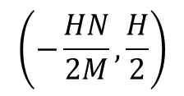
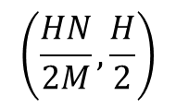
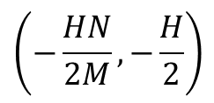
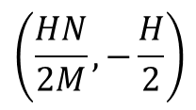
Bird’s-eye-view Generation
Determine
N (pixels)
Y
X
H
(mm)
X
M (pixels)
Y
Note: It is valid only when you think the origin of the world CS is at the center of the bird’s-eye-view image

Slide 7
Bird’s-eye-view Generation
Determine
For a point on bird’s-eye-view, the corresponding point on the world coordinate system is,
Please verify!!

Slide 8
Bird’s-eye-view Generation
Determine
The physical plane (in WCS) and the undistorted image plane can be linked via a homography matrix
If we know a set of correspondence pairs ,
can be estimated using the least-square method

Slide 9
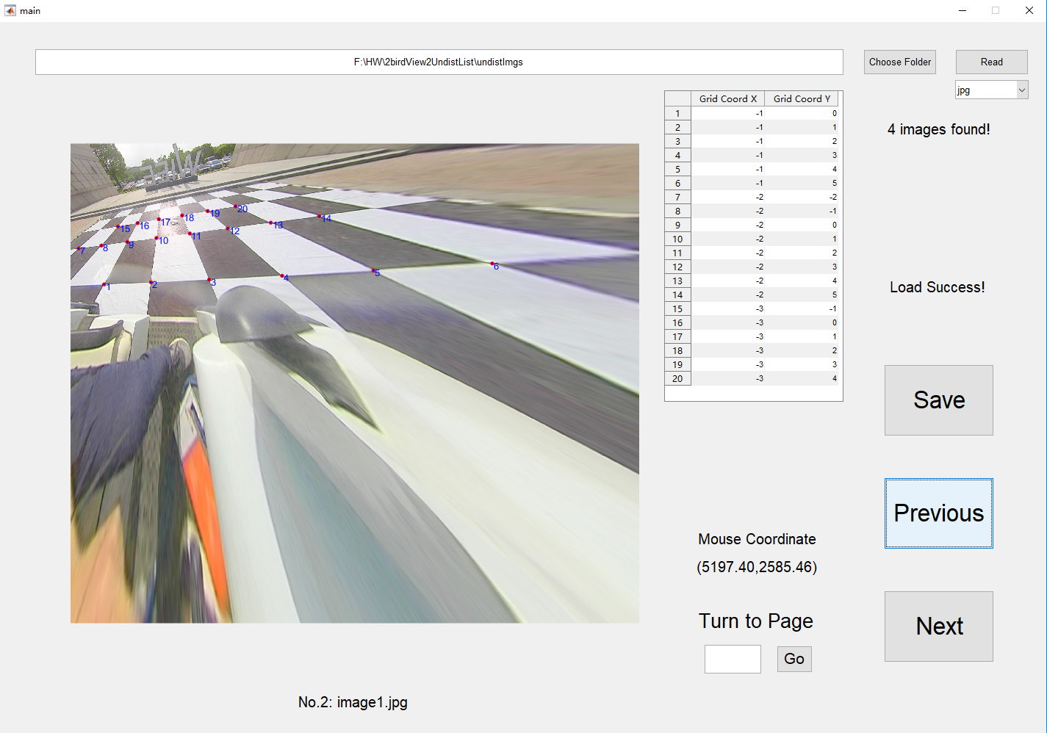
Bird’s-eye-view Generation
Determine
A set of point correspondence pairs; for each pair, we know its coordinate on the undistorted image plane and its coordinate in the WCS

Slide 10
Bird’s-eye-view Generation
When and are known, the bird’s-eye-view can be generated via,

Slide 11
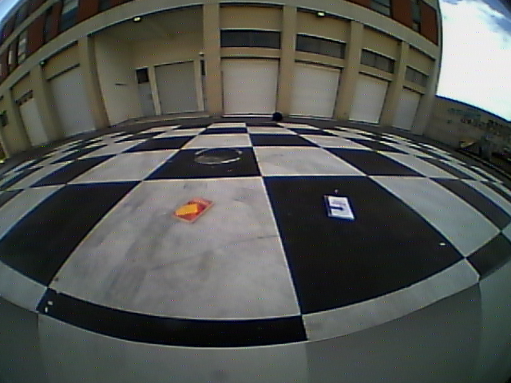
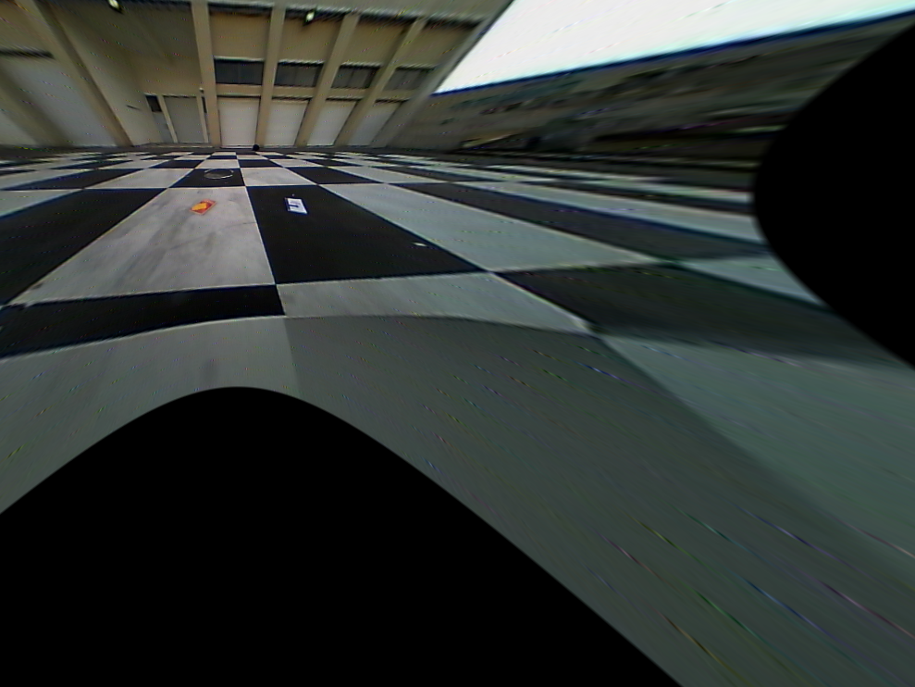
Bird’s-eye-view Generation
Another example
Original fish-eye image
Undistorted image

Slide 12
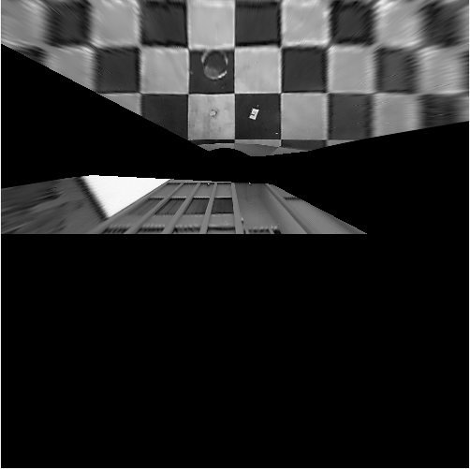
Bird’s-eye-view Generation
Another example
Original fish-eye image
Bird’s-eye-view

Slide 13
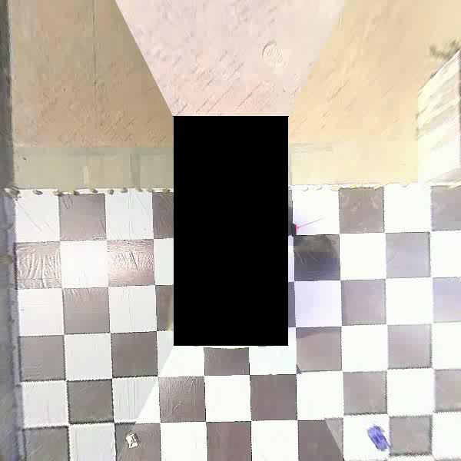
Bird’s-eye-view Generation
With multiple bird’s-eye-view from multiple cameras, a surround-view can be synthesized

Slide 14

Notes:
14

